Slide 1

SMART RESUME BUILDER
Transforming your resume into a job magnet using deep learning
Team Members:
Anushka Bhat
Kavya Nandigam
Karthik Balaji
Anjali Polansani
Pauline Korukundo

Slide 2
FUNCTIONAL REQUIREMENTS
Resume Upload and Profile Management: As a user, I want to upload my existing resume so that the system can extract my skills, experience, and qualifications to build a personalized profile.
Job Description Analysis: As a user, I want to upload or paste a job description so that the system can analyze the job requirements and identify the key skills and qualifications needed for the role.
Skill Gap Analysis
As a user, I want the system to identify any skill gaps between my profile and the job description so that I know what areas I need to improve.
As a user, I want the system to provide a score of how well I fit the job description so that I can know my chances of getting the job.
As a user, I want the system to provide a detailed explanation of the score that indicates how well I fit the job, including the key factors that contributed to the score, so that I can understand my strengths and areas for improvement with the job requirements.

Slide 3
FUNCTIONAL REQUIREMENTS
4. Resume Generation
As a user, I want the system to generate a resume that aligns my skills and experiences with the job description so that my resume is tailored to the job I am applying for.
As a user, I want the generated resume to be formatted into key sections such as a summary, skills, experience, and education, so that it looks complete.
As a user, I want the system to prioritize and reorder my skills and experience based on the job description requirements so that the most relevant information appears first.
As a user, I want the system to generate a one-page resume so that it meets US resume standards.
5. Saving and Exporting
As a user, I want to be able to save the generated resume in different formats (e.g., PDF, Word, plain text) so that I can submit it to various job applications.

Slide 4
FUNCTIONAL REQUIREMENTS
6. Feedback and Iteration
As a user, I want to provide feedback on the generated resume’s quality and relevance so that the system can improve future suggestions.
7. Resume Customization
As a user, I want to edit the generated resume so that I can adjust and add any personal touches before submitting it.

Slide 5
FUNCTIONAL REQUIREMENTS
NICE TO HAVE
1. Resume Generation
As a user, I want the system to generate multiple versions of the resume with different layouts so that I can choose the one that suits my application best.
As a user, I want the system to compare the generated resume with the input resume so that I can verify that it has been enhanced.
2. User Guidance and Support
As a user, I want to receive tips and explanations on how the system generated the resume and matched my profile to the job description so that I understand the process and can make informed edits.
As a user, I want access to a help section or tutorial that guides me through using the system so that I can maximize its potential for my job applications.
3. Security and Privacy: As a user, I want my personal information, skills, and experience to be handled securely so that my data remains private and protected.

Slide 6

NON FUNCTIONAL REQUIREMENTS

Slide 7
MUST HAVE
1. Performance
As a user, I want the resume generation process to be completed within 10 seconds so that I don't have to wait long for the results.
As a user, I want the system to handle at least 10 concurrent users without performance degradation so that the service is reliable during peak times.
2. Usability: As a user, I want the user interface to be intuitive so that I can generate and customize resumes without needing technical knowledge.
3. Data Quality: As a user, I want the extracted skills and experience data to be accurate so that the generated resume reflects my true qualifications.

Slide 8
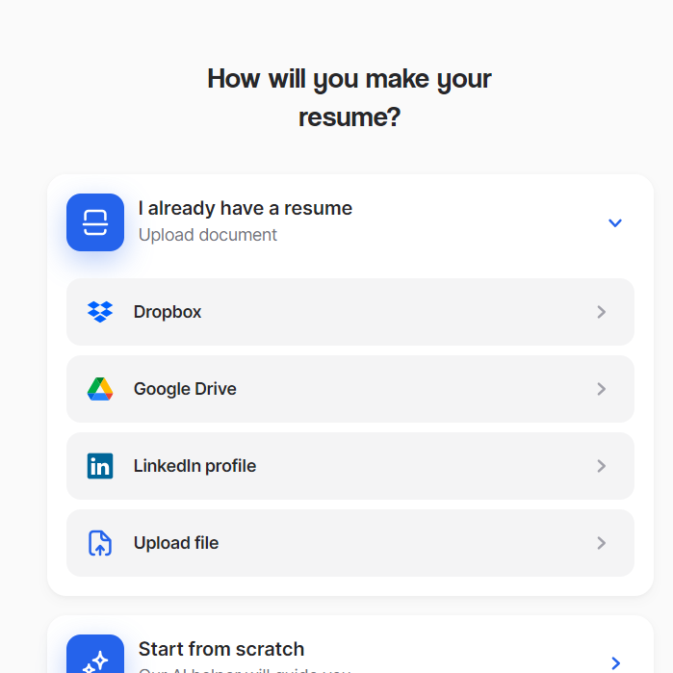
NICE TO HAVE
As a developer, I want the ability to integrate third-party services (e.g., LinkedIn API, Indeed, Job Portals) so that the system can be extended with additional capabilities.

Slide 9
THANKS
Do you have any questions?
PLEASE KEEP THIS SLIDE FOR ATTRIBUTION

